Slide 1
Query Concepts
Advanced SQL for Analysts

Slide 2
agenda
Talk through concepts regarding how to organize queries and how to control costs
CTEs
Nested Data
BigQuery cost structure
Sharded tables
Partitioned tables
Clustered tables

Slide 3
What is a cte
Common Table Expression (CTE)
Temporary named result set in SQL
Can be referenced multiple times w/in the same query
Similar to a derived table but (typically) more understandable
Specified using a “WITH” clause which specifies the name of the CTE
Can name multiple tables using “AS”
Allows you to simplify complex queries by breaking them into parts
Can improve performance (over subqueries) in many cases
Can be run recursively

Slide 4
Example
Simple query:
select
bikeid,
start_station_id,
end_station_id,
start_time,
duration_minutes
from `bigquery-public-data.austin_bikeshare.bikeshare_trips`

Slide 5
Example with cte
with trip_simple as (
select
bikeid,
start_station_id,
end_station_id,
start_time,
duration_minutes
from `bigquery-public-data.austin_bikeshare.bikeshare_trips`
)
select * from trip_simple;

Slide 6
More complex cte
with trip_simple as (
select
bikeid,
start_station_id,
end_station_id,
start_time,
duration_minutes
from `bigquery-public-data.austin_bikeshare.bikeshare_trips`
),
trip_agg as(
select
start_station_id,
count(1) as n
from trip_simple
group by 1
)
select * from trip_simple;
In this case, “trip_agg” doesn’t actually run.
Look at execution graph when we skip trip_agg

Slide 7
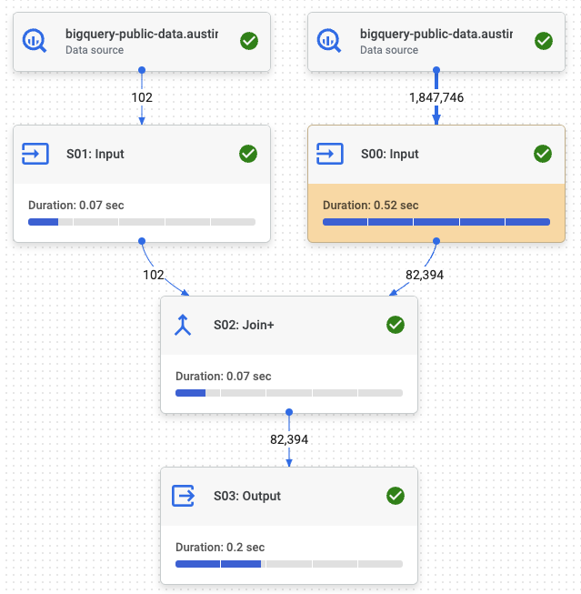
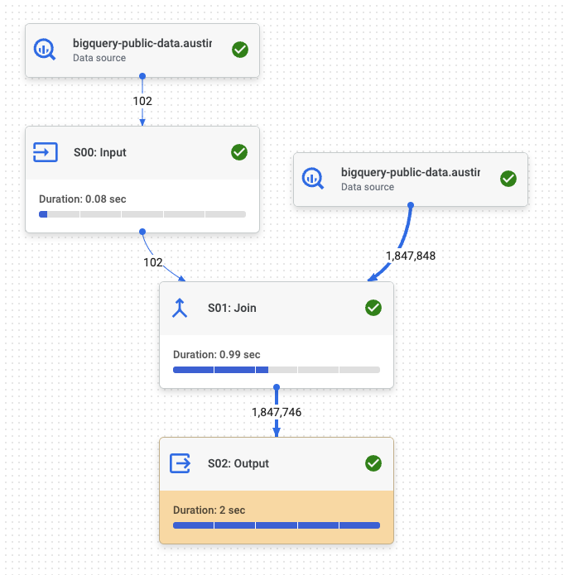
Query optimization
Join to aggregation CTE
Skip the aggregation CTE

Slide 8
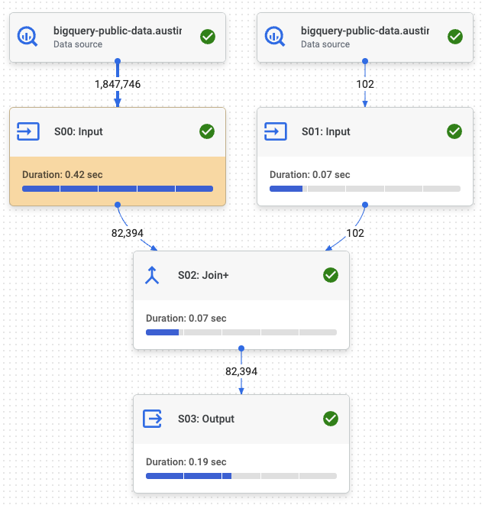
Subquery version
select
t1.*,
t2.council_district
from (select start_station_id,bikeid,count(1) as n from `bigquery-public-data.austin_bikeshare.bikeshare_trips` group by 1,2) t1
left join `bigquery-public-data.austin_bikeshare.bikeshare_stations` t2
on t1.start_station_id = t2.station_id

Slide 9
In-class exercise
Write a query that counts the number of starting and ending trips by station and day using a CTE
How do you think we should do this?
What are some things we need to think about?

Slide 10
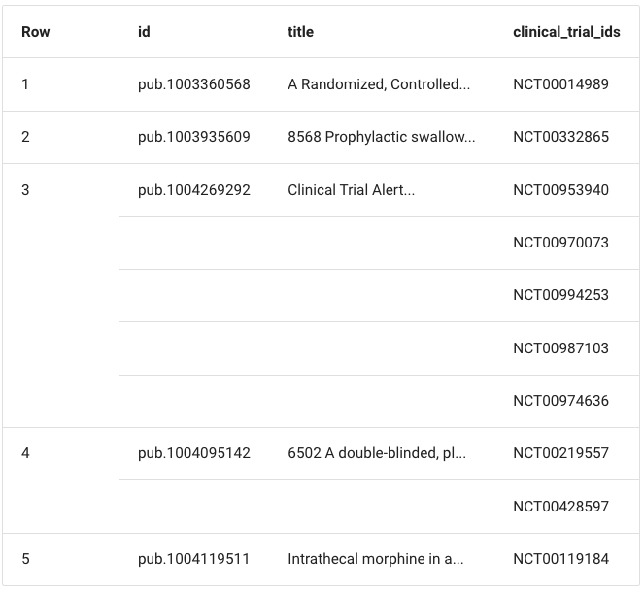
Nested data
BigQuery feature that allows you to hold multiple values for each row in a table
This is an example of an array or repeated field.
Can also have nested fields and nested/repeated fields.
Reference: https://bigquery-lab.dimensions.ai/tutorials/04-nested/

Slide 11
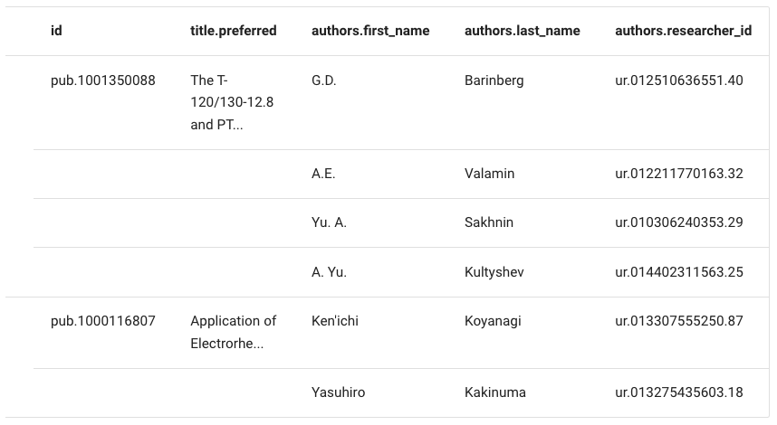
Nested and repeated data
Title is a nested field with one repeated value
Authors is also a nested field with three repeated values

Slide 12
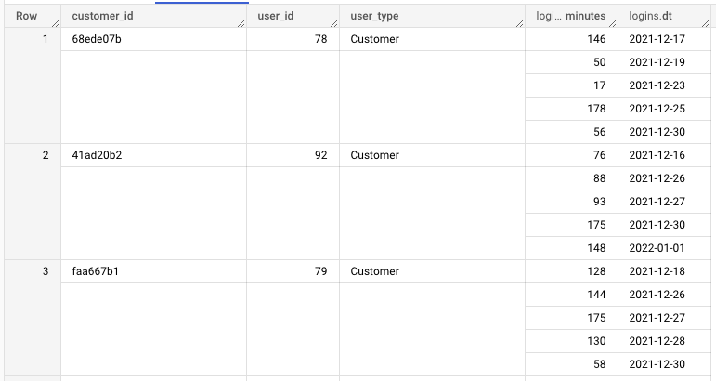
Arrays and structs
An ARRAY (repeated) is an ordered collections of values
A STRUCT (nested) is a collection of named fields that can contain values of different types
The user db we created has an example of nested/repeated fields.
Here “logins” is an array that contains the struct “logins”

Slide 13
Why?
Nested/repeated fields are one way we can denormalize our data
This method stores values all in one place, rather than spreading it out to multiple tables
It also avoid joins when needing the additional information
Allows you to perform certain functions without using a ”group by”
Can easily flatten the table using a cross-join with an unnest statement

Slide 14
User db example
If login data was shared between two tables, what would we need to do?
select
customer_id,
user_id,
user_type,
logins
from `adv-sql-spring-23.saas_user_db.users`
where array_length(logins) >= 5

Slide 15
In-class exercise
Select * from users table
Select only customer id, user id, user type and login information
Repeat where we only get user records with more than 5 logins
Count total logins by user (use array_length)
Calculate average minutes by user
Using subquery
Flattening the data

Slide 16
What does this error mean?
Cannot access field dt on a value with type ARRAY<STRUCT<minutes INT64, dt DATE>> at [23:10]

Slide 17
Costs in bigquery
On-demand Pricing
Pay for each query
Depends on how much data is scanned during the query
Queries are cached, so you may not be charged for running the same query repeatedly
Pay $5 per TB processed
The first 1 TB per month is free
(Potentially very generous)
Flat-rate Pricing
Purchase ”slots” which are virtual CPUs
This is dedicated processing power that can be used to run queries
Ensures more consistent performance b/c you get the same resources all the time
Might over pay if you do not use all the capacity

Slide 18
Notes about on-demand pricing
Note the following regarding on-demand query charges:
BigQuery uses a columnar data structure.
You're charged according to the total data processed in the columns you select,
Total data per column is calculated based on the types of data in the column.
You aren't charged for queries that return an error or for queries that retrieve results from the cache. For procedural language jobs this consideration is provided at a per-statement level.
When you run a query, you're charged according to the data processed in the columns you select, even if you set an explicit LIMIT on the results.
Partitioning and clustering your tables can help reduce the amount of data processed by queries. As a best practice, use partitioning and clustering whenever possible.
https://cloud.google.com/bigquery/pricing#on_demand_pricing

Slide 19
Partitioning / clustering
Partitioning
Table is divided into segments (called partitions)
Makes it easier to manage and query your data
Allows BigQuery to skip partitions when using a filter
Can help reduce costs
Cannot use legacy SQL
Only one column can be used as a partition
Clustering
Tables that have user-defined column sort order
Can help performance and reduce query costs
Can have multiple columns
Will not get an updated query size estimate
Can ONLY use legacy SQL

Slide 20
Partitioning details
Types of partitions
Integer
Ranges of integers
Need to specify start, end and interval
Values outside the range go into an __UNPARTITIONED__ partition
Time-unit
Partition based on a date, timestamp or datetime column
Can specify the grain (hourly, daily, monthly, yearly)
Decision based on how much data you’re collecting in those windows
Ingestion-time
Based on when the data is loaded into BigQuery
Will automatically assign to partitions
There will be a new pseudo-column in the data called _PARTITIONTIME

Slide 21
In-class example
Create a table on saas_db by unnesting login data
Create a partitioned table (on login date)
Calculate how much data is scanned when doing a select * for data after 5/1/2019

Slide 22


